Slide 1
Advanced Digital Image Processing
(CEN 745)
Lecture # 1: Introduction

Slide 2


What constitutes this course?

Slide 3
Course Information
Instructor
Office Hours
Dr Samabia Tehsin
Office: Cabin # 8, XC Basement
Contact: tsamabia@yahoo.com
Displayed outside office
3
Notes:
3

Slide 4
Coure Information
Pre-requisite
Linear Algebra, Probability Theory
Course meeting times
Lectures: 1 session/week (Tuesday)

Slide 5

Course Page
http://piazza.com/bahria_university_islamabad/spring2017/cen745

Slide 6


Slide 7
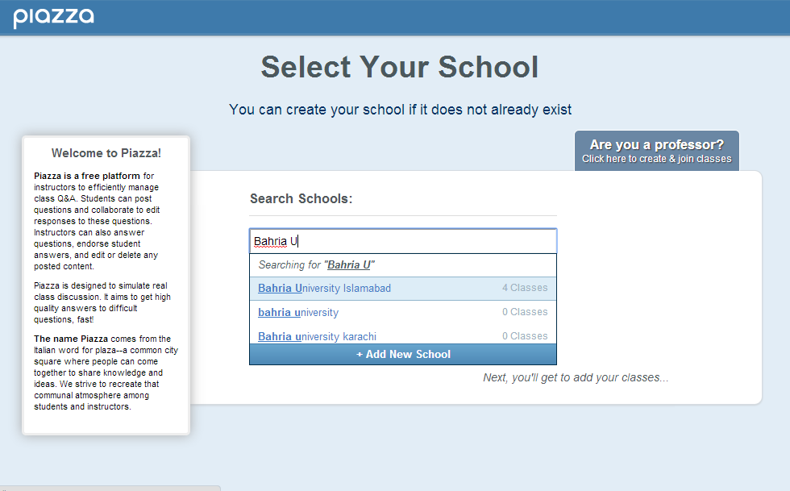

Slide 8
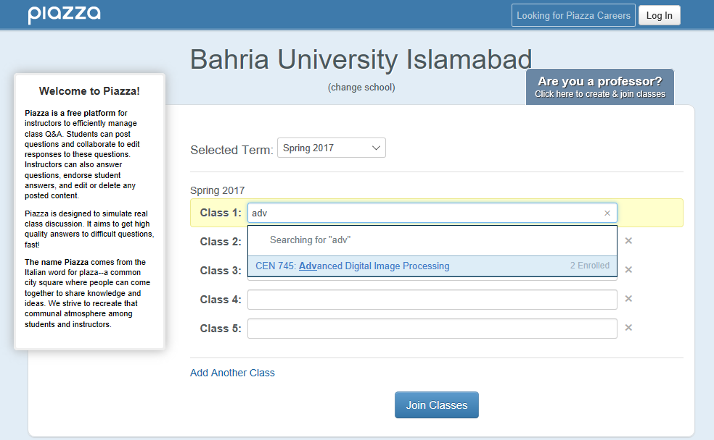

Slide 9
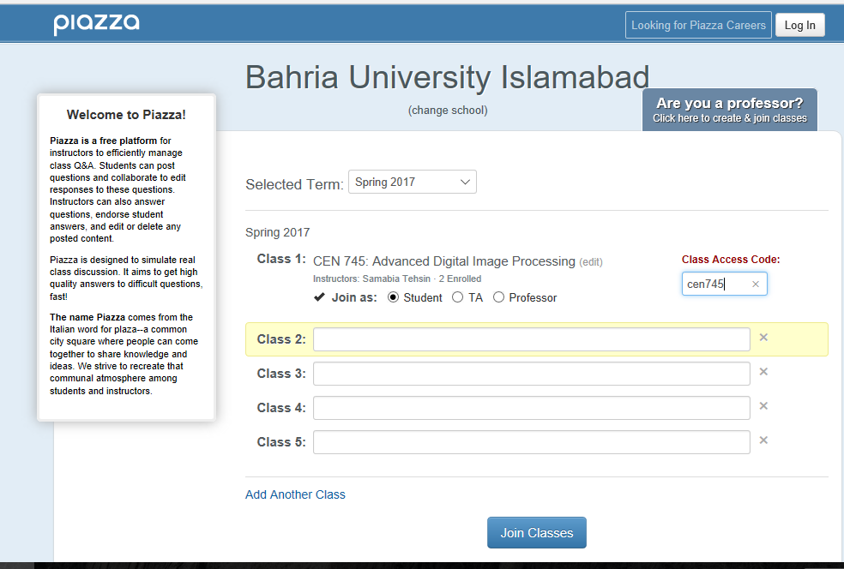

Slide 10
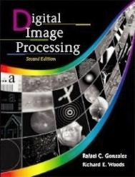
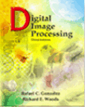
Course Information
Books
Digital Image Processing, Rafael C. Gonzalez & Richard E. Woods, Addison-Wesley
Second Edition
Third Edition
Notes:
10

Slide 11
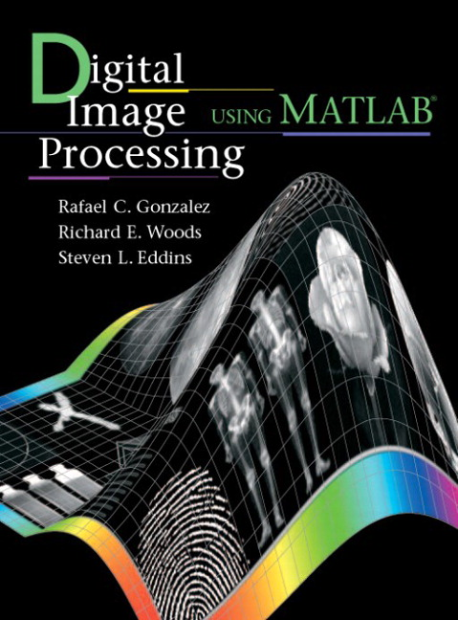
Course Information
Books
Digital Image Processing using Matlab, Rafael C. Gonzalez, Richard E. Woods and Steven L. Eddins.
Second Edition
Notes:
11

Slide 12

Course Objectives
Develop an understanding of basic Digital Image Processing techniques through lectures, study, and exercises.
Develop fluency with a Digital Image Processing (DIP) Software.
Implement the theoretical concepts discussed in the course to demonstrate your ability of integrating the Mathematical theory with practical issues.

Slide 13

Course Contents
Introduction to Digital Image Processing, Computer Vision and Pattern Recognition
Image acquisition, image sampling and quantization
Image enhancement in the spatial domain: Gray level transformations, histogram processing smoothing and sharpening filters
Image enhancement in the frequency domain – Fourier transform, Frequency domain filtering
Image Segmentation: Detection of discontinuities, edges, boundaries, thresholding, region-based segmentation
Morphological Image Processing: Image morphology, Dilation, Erosion and derived operators and transforms
Color Image Processing
Image Compression
Pattern Recognition: Shape representation and description, clustering and classification

Slide 14
Grading Policy
Credits : 3 + 0

Slide 15


Slide 16


Image Processing
Image Analysis
Pattern Recognition
Machine Vision
Computer Vision

Slide 17
Image Processing & Machine Vision
Continuum from Image Processing to Machine Vision:
low, mid and high-level processes
Low Level Process
Input: Image Output: Image
Examples: Noise removal, image sharpening
Image Processing
Notes:
17

Slide 18
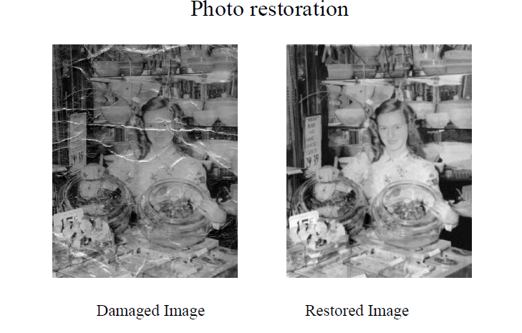
Example: Low Level Processing
Notes:
18

Slide 19
Image Processing & Machine Vision
Continuum from Image Processing to Machine Vision:
low, mid and high-level processes
Low Level Process
Mid Level Process
Input: Image Output: Image
Examples: Noise removal, image sharpening
Input: Image Output: Attributes
Examples: Object recognition, segmentation
Image Processing
Notes:
19

Slide 20


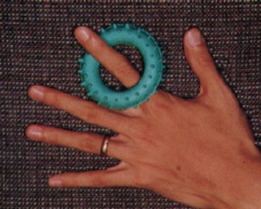

Example: Mid Level Processing
Segmentation of image into regions
Notes:
20

Slide 21
Image Processing & Machine Vision
Continuum from Image Processing to Machine Vision:
low, mid and high-level processes
Low Level Process
Mid Level Process
High Level Process
Input: Image Output: Image
Examples: Noise removal, image sharpening
Input: Image Output: Attributes
Examples: Object recognition, segmentation
Input: Attributes/Image Output: Understanding
Examples: Scene understanding, autonomous navigation
Image Processing
Machine Vision
Notes:
21

Slide 22
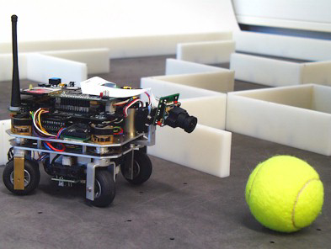
Example: High Level Processing
Robot Navigation
Notes:
22

Slide 23
Image Processing & Machine Vision
Continuum from Image Processing to Machine Vision:
low, mid and high-level processes
In this course
Low Level Process
Mid Level Process
High Level Process
Input: Image Output: Image
Examples: Noise removal, image sharpening
Input: Image Output: Attributes
Examples: Object recognition, segmentation
Input: Attributes/Image Output: Understanding
Examples: Scene understanding, autonomous navigation
Image Processing
Machine Vision
Notes:
23

Slide 24
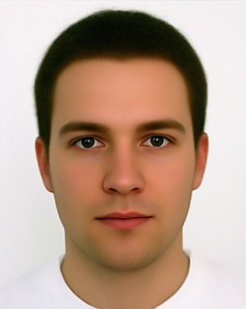
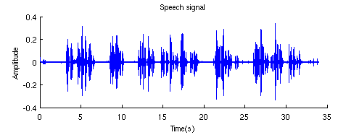

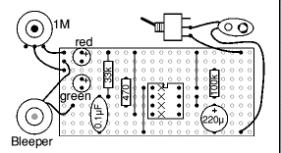


Pattern Recognition
A pattern is the opposite of a chaos, it is an entity that can be given a name
Notes:
24

Slide 25
Recognition
Identification of a pattern as a member of a category
Classification (Supervised: known categories)
Clustering (Unsupervised: learning categories)
Notes:
25

Slide 26
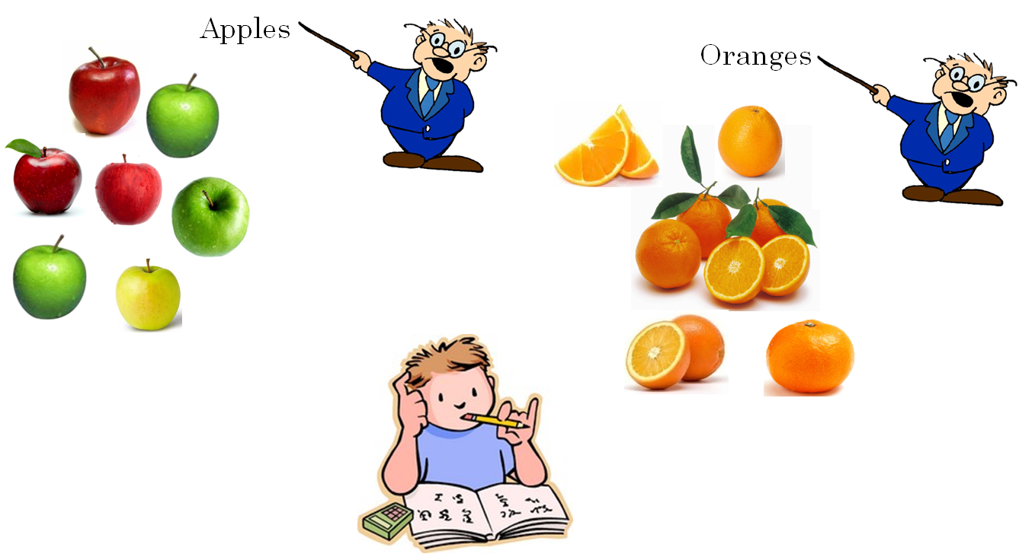
Classification

Slide 27

Classification
You had some training example or ‘training data’
The examples were ‘labeled’
You used those examples to make the kid ‘learn’ the difference between an apple and an orange

Slide 28
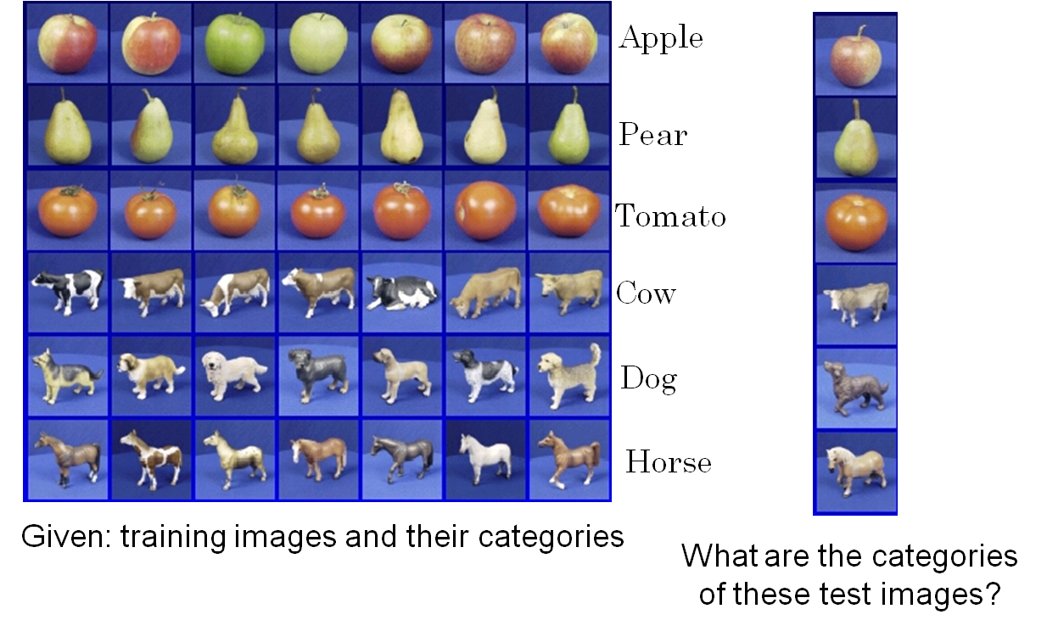
Classification

Slide 29


Clustering
There are two types of fruit in the basket, separate them into two ‘groups’

Slide 30
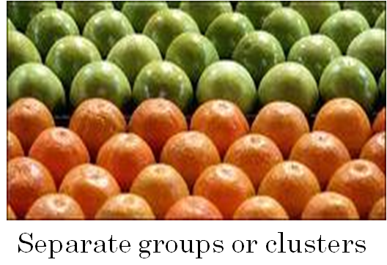
Clustering
The data was not ‘labeled’ you did not tell which are apples which are oranges
May be the kid used the idea that things in the same group should be similar to one another as compared to things in the other group
Groups - Clusters

Slide 31














Classification vs. Clustering
Category “A”
Category “B”
Clustering
Classification
Notes:
31

Slide 32
Pattern Class
A collection of similar (not necessarily identical) objects
Intra-class variability
Inter-class similarity
Notes:
32

Slide 33





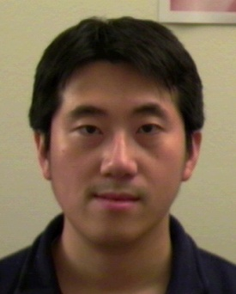
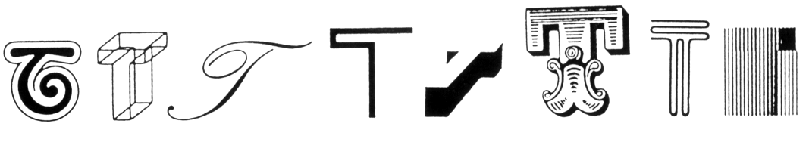
Pattern Class
Intra-class variability
The letter “T” in different typefaces
Same face under different expression, pose, illumination
Notes:
33

Slide 34

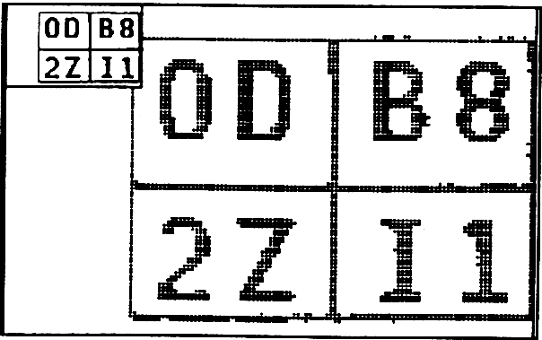
Pattern Class
Inter-class similarity
Characters that look similar
Identical twins
Notes:
34

Slide 35
Features
Features are the individual measurable properties of the signal being observed.
The set of features used for learning/recognition is called feature vector.
The number of used features is the dimensionality of the feature vector.
n-dimensional feature vectors can be represented as points in n-dimensional feature space

Slide 36
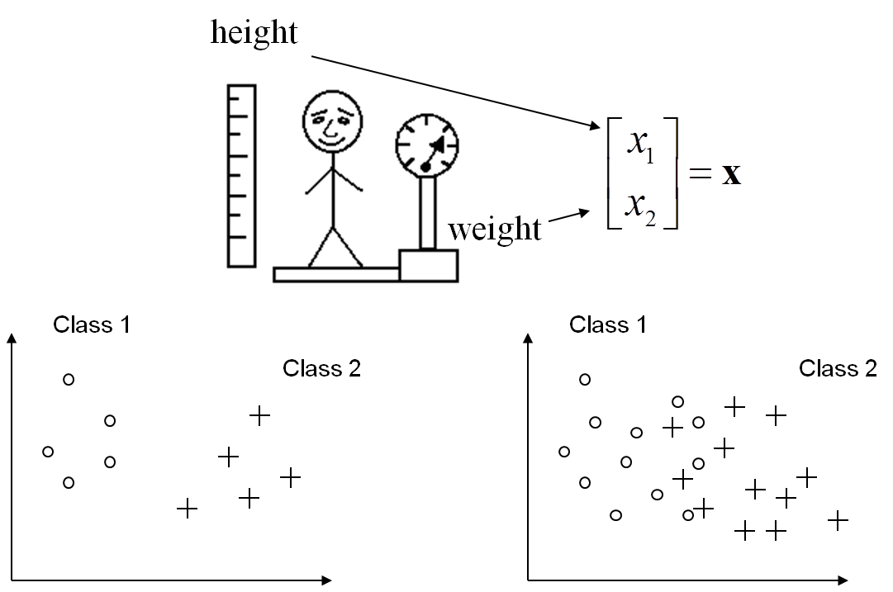
Features

Slide 37
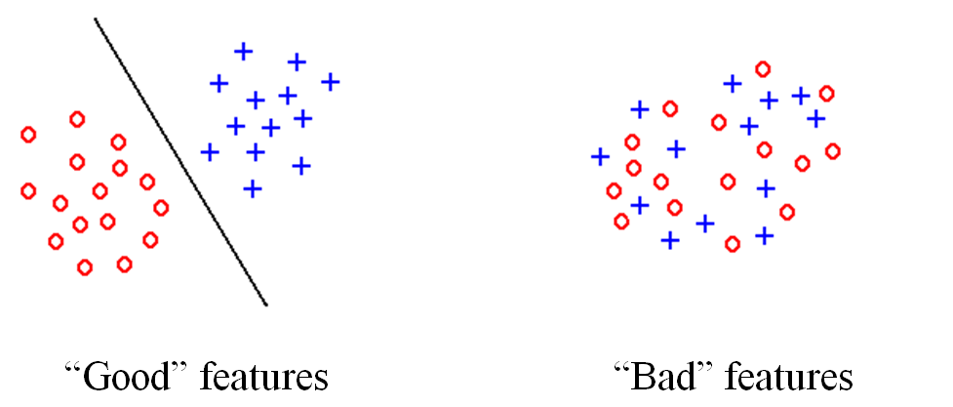
Feature Extraction
Feature extraction aims to create discriminative features good for learning
Good Features
Objects from the same class have similar feature values.
Objects from different classes have different values.

Slide 38
Example Applications
Notes:
38

Slide 39
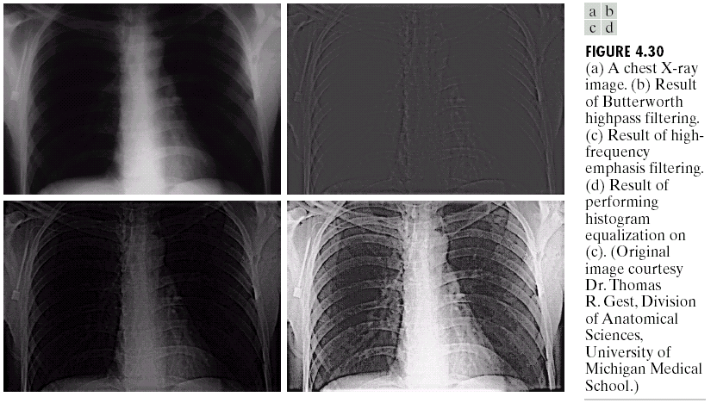
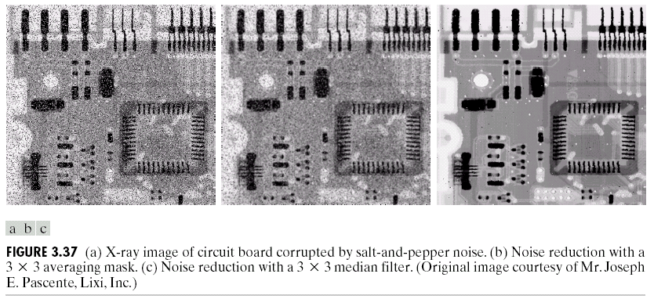
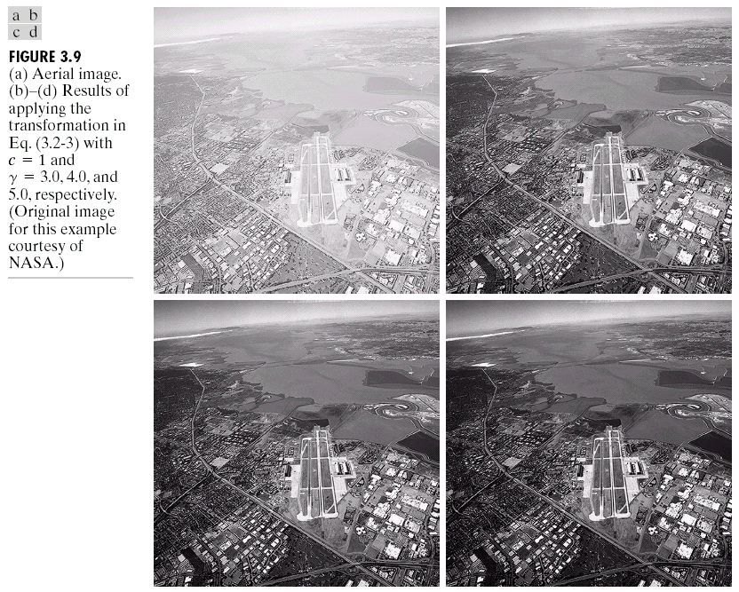
Examples: Image Enhancement
Notes:
39

Slide 40
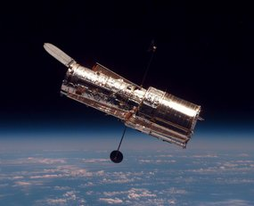
Examples: The Hubble Telescope
Launched in 1990 the Hubble telescope can take images of very distant objects
However, an incorrect mirror made many of Hubble’s images useless
Image processing techniques were used to fix this
Notes:
40

Slide 41
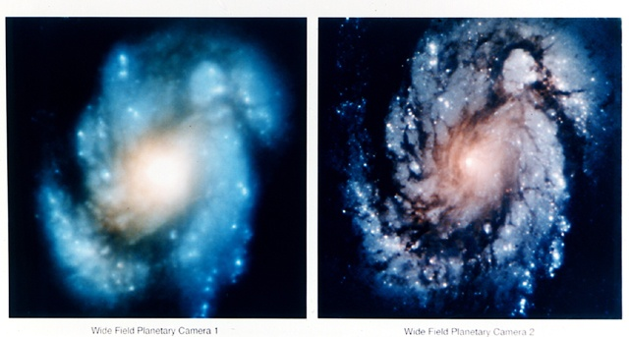
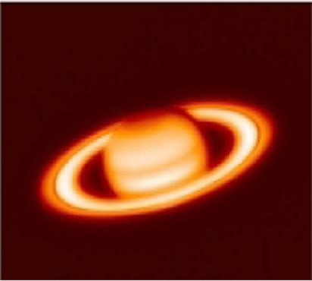
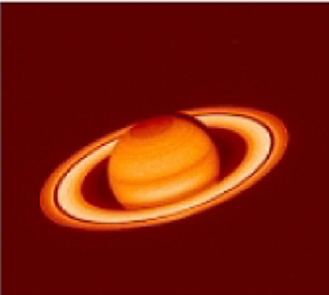
Examples: The Hubble Telescope
Notes:
41

Slide 42
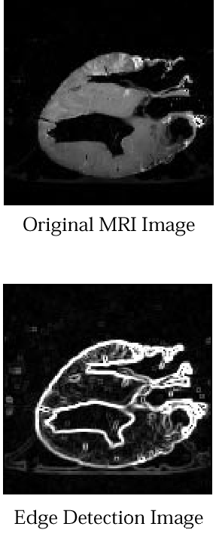
Examples: Medicine
Original Image of a Dog Heart
Separation of tissues
Notes:
42

Slide 43
Examples: Medicine
Microscopic tissue data - Cancer Detection
Notes:
43

Slide 44
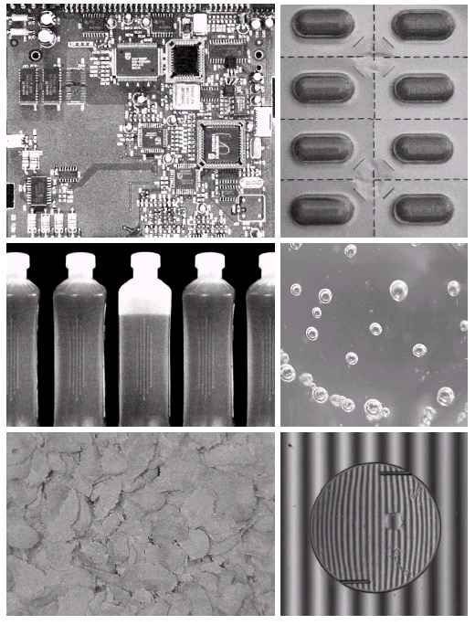
Examples: Industrial Inspection
Human operators are expensive & slow
Make machines do the job instead
44
Notes:
44

Slide 45
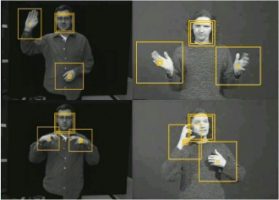
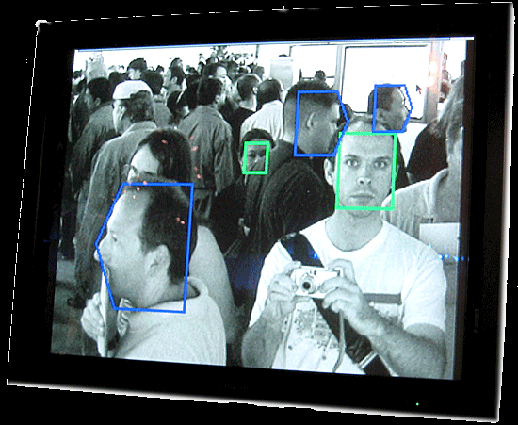
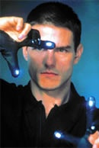
Examples: HCI
Try to make human computer interfaces more natural
Gesture recognition
Facial Expression Recognition
Lip reading
Notes:
45

Slide 46
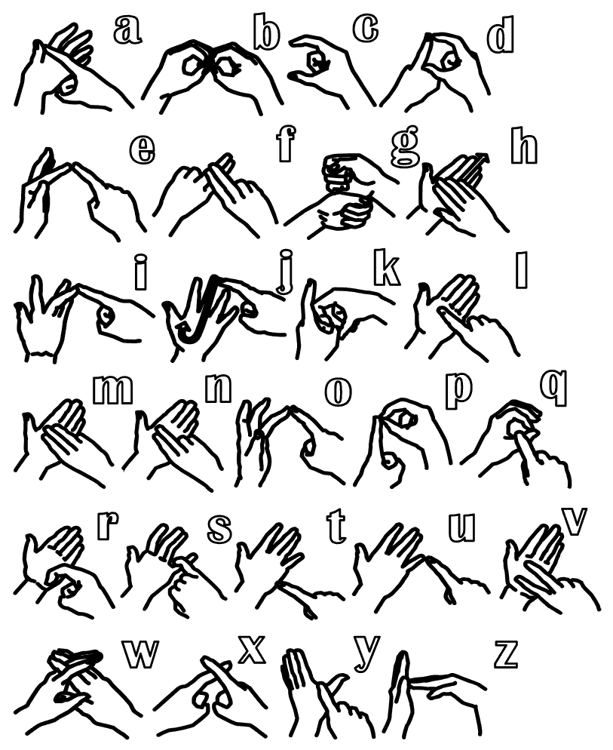
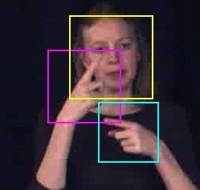
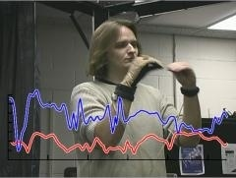
Examples: Sign Language/Gesture Recognition
British Sign Language Alphabet
Notes:
46

Slide 47
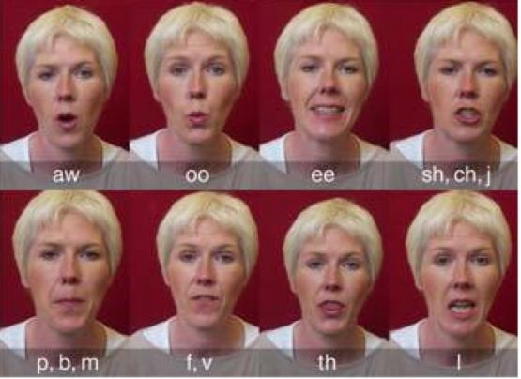
Examples: Lip Reading
Find?
ee
oo
sh
Notes:
47

Slide 48
Examples: Lip Reading
Notes:
48

Slide 49
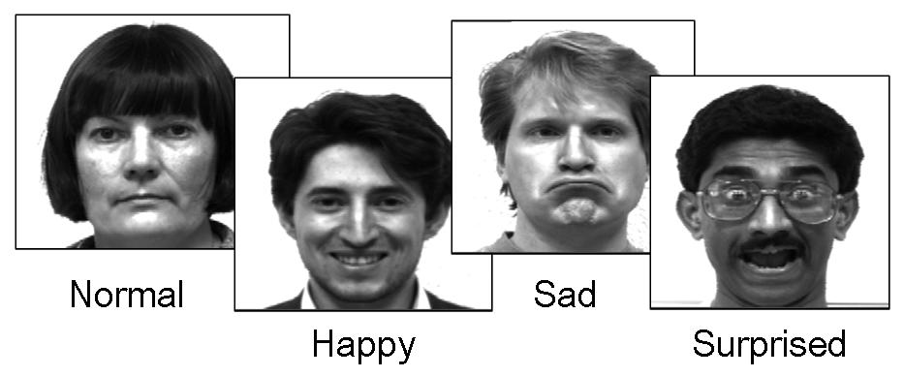
Examples: Facial Expression Recognition
Implicit customer feedback
Notes:
49

Slide 50
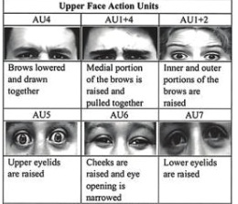
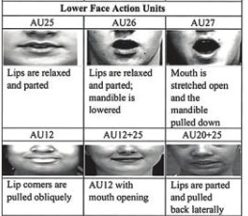
Examples: Facial Expression Recognition
Implicit customer feedback
Notes:
50

Slide 51
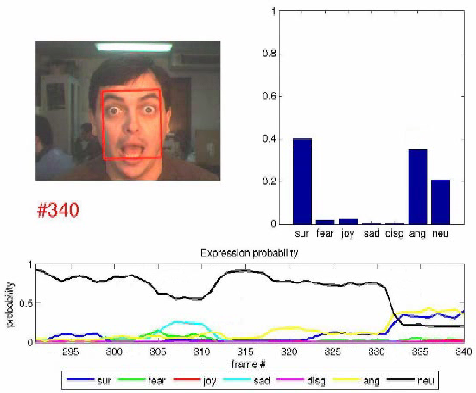
Examples: Facial Expression Recognition
Implicit customer feedback
Notes:
51

Slide 52
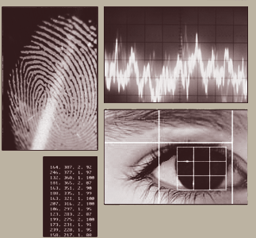
Examples: Biometrics
Biometrics - Authentication techniques
Physiological Biometrics
Face, IRIS, DNA, Finger Prints
Behavioral Biometrics
Typing Rhythm, Handwriting, Gait
Notes:
52

Slide 53
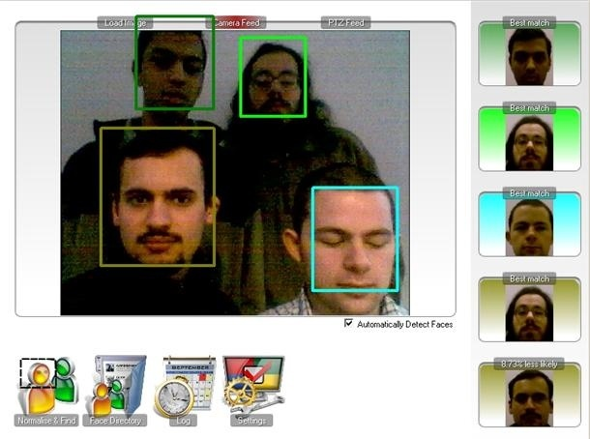
Examples: Biometrics – Face Recognition
Notes:
53

Slide 54
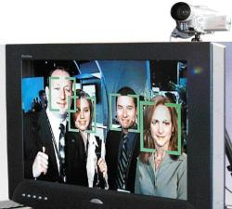
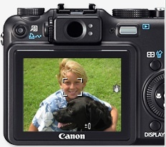
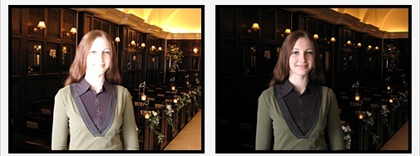
Faces and Digital Cameras
Setting camera focus via face detection
Camera waits for everyone to smile to take a photo [Canon]
Automatic lighting correction based on face detection

Slide 55
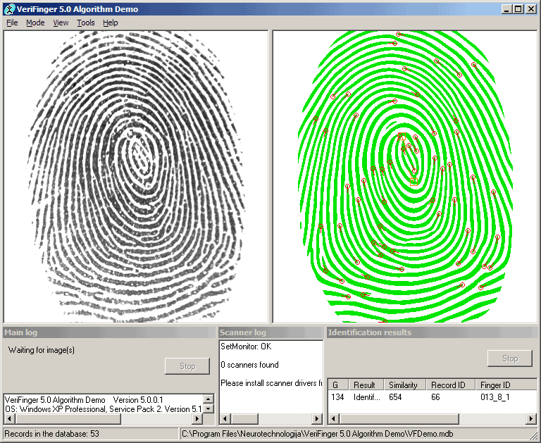
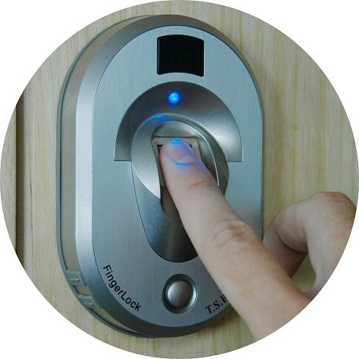
Examples: Biometrics – Finger Print Recognition
Notes:
55

Slide 56
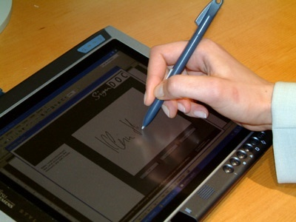
Examples: Biometrics – Signature Verification
Notes:
56

Slide 57
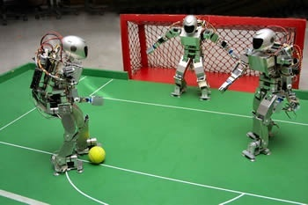
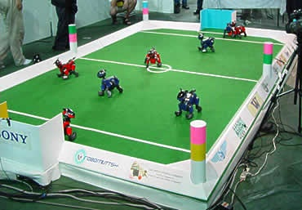
Examples: Robotics
Notes:
57

Slide 58


Examples: Robotics
AIBO
Notes:
58
AIBO is an iconic series of robotic pets designed and manufactured by Sony.

Slide 59

Examples: Optical Character Recognition
Convert document image into text
Notes:
59

Slide 60

Examples: Optical Character Recognition
Indexing and Retrieval
Image Source: CEDAR
Notes:
60

Slide 61
Examples: Optical Character Recognition
License Plate Recognition
Notes:
61

Slide 62



Examples: Optical Character Recognition
Automatic Mail Sorting
Notes:
62

Slide 63


Vision from Mobile Phones
Situated search
Yeh et al., MIT

Slide 64

Vision from Mobile Phones
Commercial services coming out…
~30’000 movie posters indexed
Query-by-image from mobile phone available in Germany and Switzerland

Slide 65

Business card readers

Slide 66

Translation for travellers

Slide 67






Safety and Security
Autonomous robots
Driver assistance
Monitoring pools
Pedestrian detection
Surveillance

Slide 68
Summary of Applications
Problem Domain | Application | Input Pattern | Output Class
Document Image Analysis | Optical Character Recognition | Document Image | Characters/words
Document Classification | Internet search | Text Document | Semantic categories
Document Classification | Junk mail filtering | Email | Junk/Non-Junk
Multimedia retrieval | Internet search | Video clip | Video genres
Speech Recognition | Telephone directory assistance | Speech waveform | Spoken words
Natural Language Processing | Information extraction | Sentence | Parts of Speech
Biometric Recognition | Personal identification | Face, finger print, Iris | Authorized users for access control
Medical | Computer aided diagnosis | Microscopic Image | Healthy/cancerous cell
Military | Automatic target recognition | Infrared image | Target type
Industrial automation | Fruit sorting | Images taken on conveyor belt | Grade of quality
Bioinformatics | Sequence analysis | DNA sequence | Known types of genes
Notes:
68

Slide 69
Image Sources
Electromagnetic (EM) band imaging
Gamma ray band images
X-ray band images
Ultra violet band images
Visual light and infra-red images
Images based on micro waves or radio waves
Non-EM band imaging
Acoustic and ultrasonic images
Electron microscopy
Computer generated images (synthetic)

Slide 70


Light & EM Spectrum
EM Waves
A stream of mass less particles each travelling in a wave like pattern, moving at the speed of light and contains a certain bundle of energy
The electromagnetic spectrum is split up in to bands according to the energy per photon
Highest Energy
Lowest Energy

Slide 71
Examples: Imaging in EM bands
Spectral Band | Example
Gamma-Rays | Nuclear Medicine (Radioactive isotope injected in the patient)
X-Rays | Medical Diagnostic
Ultraviolet | Fluorescence microscopy
Visible & Infrared | Remote sensing, industrial inspection, …
Microwave | Radar
Radio | Medicine – MRI

Slide 72

Examples: Imaging other Modalities
Sound
Geological Applications – Oil and Gas Exploration
Medicine – Ultrasound Imaging
Synthetic Images
Computer generated
A synthetic image

Slide 73
Key Stages in DIP
Image Restoration
Morphological Processing
Image Enhancement
Segmentation
Image Acquisition
Representation & Description
Object Recognition
Problem Domain
Colour Image Processing
Image Compression

Slide 74

Key Stages in DIP
Image Restoration
Morphological Processing
Image Enhancement
Segmentation
Image Acquisition
Representation & Description
Object Recognition
Problem Domain
Colour Image Processing
Image Compression

Slide 75

Key Stages in DIP
Image Restoration
Morphological Processing
Image Enhancement
Segmentation
Image Acquisition
Representation & Description
Object Recognition
Problem Domain
Colour Image Processing
Image Compression

Slide 76

Key Stages in DIP
Image Restoration
Morphological Processing
Image Enhancement
Segmentation
Image Acquisition
Representation & Description
Object Recognition
Problem Domain
Colour Image Processing
Image Compression

Slide 77

Key Stages in DIP
Image Restoration
Morphological Processing
Image Enhancement
Segmentation
Image Acquisition
Representation & Description
Object Recognition
Problem Domain
Colour Image Processing
Image Compression

Slide 78

Key Stages in DIP
Image Restoration
Morphological Processing
Image Enhancement
Segmentation
Image Acquisition
Representation & Description
Object Recognition
Problem Domain
Colour Image Processing
Image Compression

Slide 79

Key Stages in DIP
Image Restoration
Morphological Processing
Image Enhancement
Segmentation
Image Acquisition
Representation & Description
Object Recognition
Problem Domain
Colour Image Processing
Image Compression

Slide 80

Key Stages in DIP
Image Restoration
Morphological Processing
Image Enhancement
Segmentation
Image Acquisition
Representation & Description
Object Recognition
Problem Domain
Colour Image Processing
Image Compression

Slide 81

Key Stages in DIP
Image Restoration
Morphological Processing
Image Enhancement
Segmentation
Image Acquisition
Representation & Description
Object Recognition
Problem Domain
Colour Image Processing
Image Compression

Slide 82

Key Stages in DIP
Image Restoration
Morphological Processing
Image Enhancement
Segmentation
Image Acquisition
Representation & Description
Object Recognition
Problem Domain
Colour Image Processing
Image Compression

Slide 83
Acknowledgements
Statistical Pattern Recognition: A Review – A.K Jain et al., PAMI (22) 2000
Pattern Recognition and Analysis Course – A.K. Jain, MSU
Pattern Classification” by Duda et al., John Wiley & Sons.
Digital Image Processing”, Rafael C. Gonzalez & Richard E. Woods, Addison-Wesley, 2002
Machine Vision: Automated Visual Inspection and Robot Vision”, David Vernon, Prentice Hall, 1991
www.eu.aibo.com/
Advances in Human Computer Interaction, Shane Pinder, InTech, Austria, October 2008
Material in these slides has been taken from, the following resources
Notes:
83

